Slide 1
Machine Learning 2024 (ML-2024) Lecture 6. Loss functions. Uncertainty estimation One way to make AI more natural is to teach it to doubt. Two main questions arise. How do you train a model to estimate the uncertainties of its own predictions? What to do with the uncertain predictions if they arise?
by Alexei Valerievich Kornaev, Dr. habil. in Eng. Sc., Researcher at the RC for AI, Assoc. Prof. of the Robotics and CV Master’s Program, Innopolis University
Researcher at the RC for AI, National RC for Oncology n.a. NN Blohin
Professor at the Dept. of Mechatronics, Mechanics, and Robotics, Orel State University

Slide 2

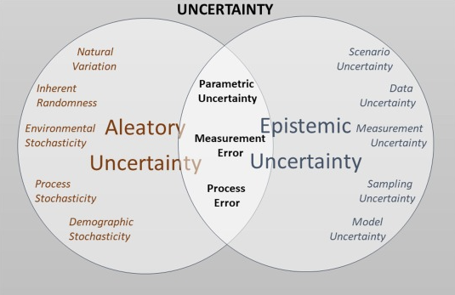

Agenda
Lecture 6. Loss Functions. Uncertainty Estimation by Alexei Kornaev
MAXIMUM LIKELIHOOD CRITERION (MLC)
UNCERTAINTY ESTIMATION USING MLC
UNCERTAINTY ESTIMATION IN GENERAL

Slide 3
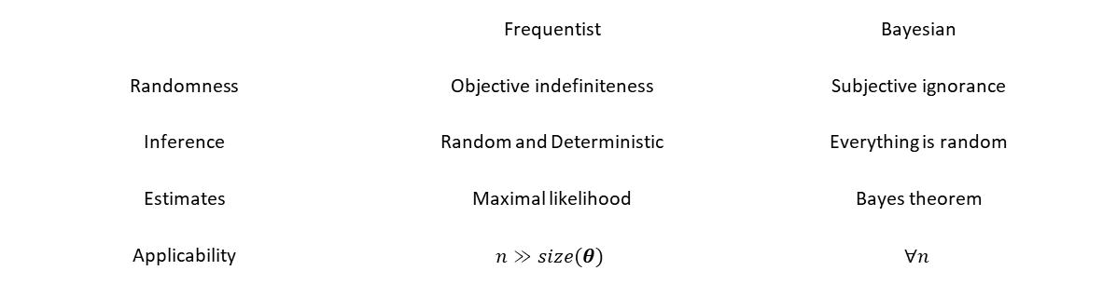
Lecture 6. Loss Functions. Uncertainty Estimation by Alexei Kornaev
Frequentist vs Bayesian frameworks
 | Frequentist | Bayesian
Randomness | Objective indefiniteness | Subjective ignorance
Inference | Random and Deterministic | Everything is random
Estimates | Maximal likelihood | Bayes theorem
Applicability | $$n≫size(θ)$$ | $$∀n$$
Deep Bayes School
3

Slide 4
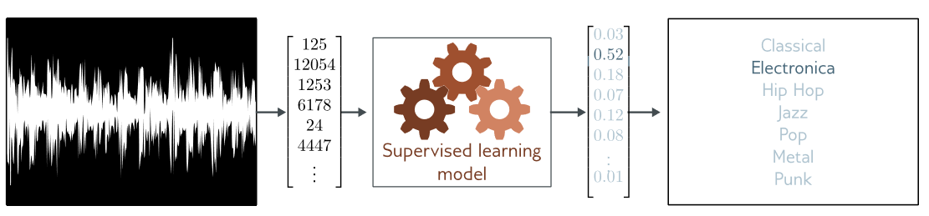
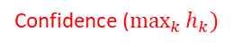
Confidence intuition
Lecture 6. Loss Functions. Uncertainty Estimation by Alexei Kornaev
Confidence ($\max_{k}{h_{k})}$
prediction
Supervised learning intuition
S. J. Prince. Understanding Deep Learning. MIT Press, 2023. URL http://udlbook.com.

Slide 5
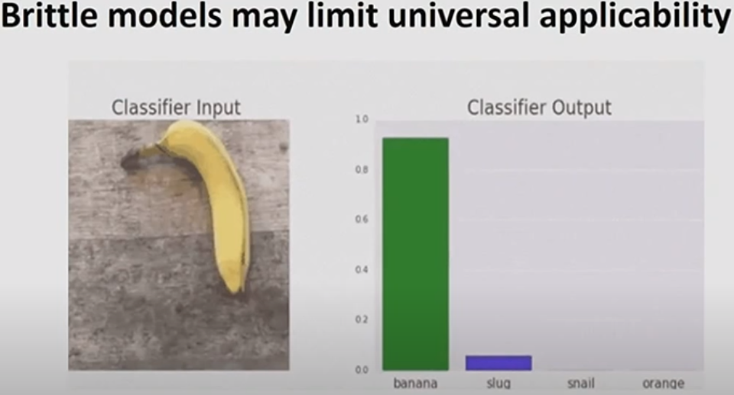
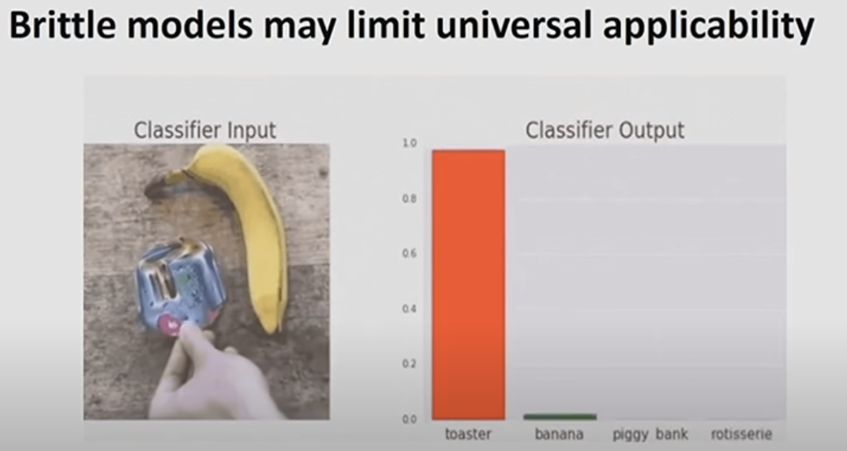
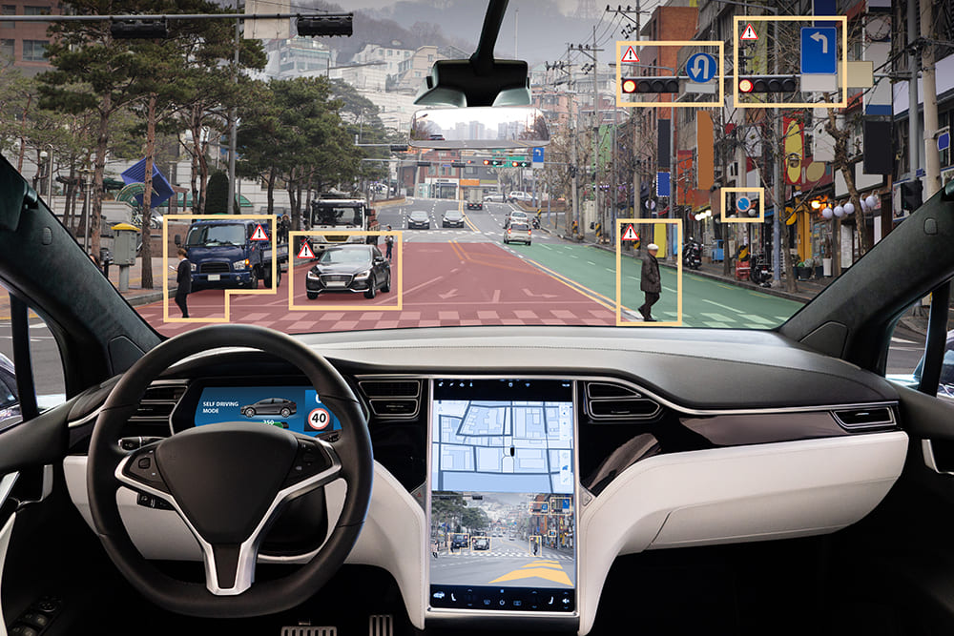
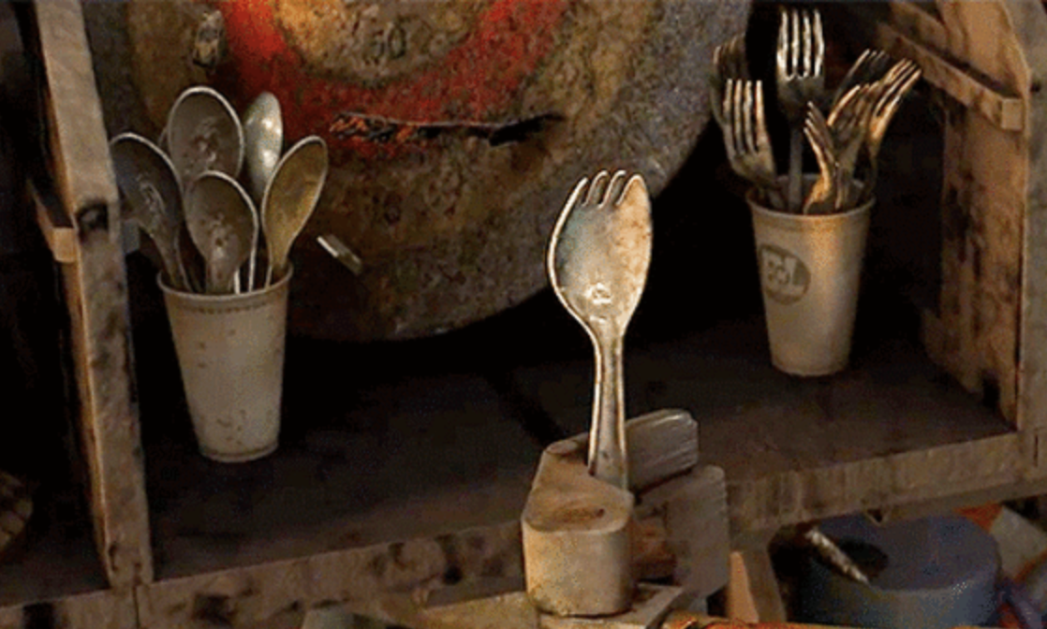
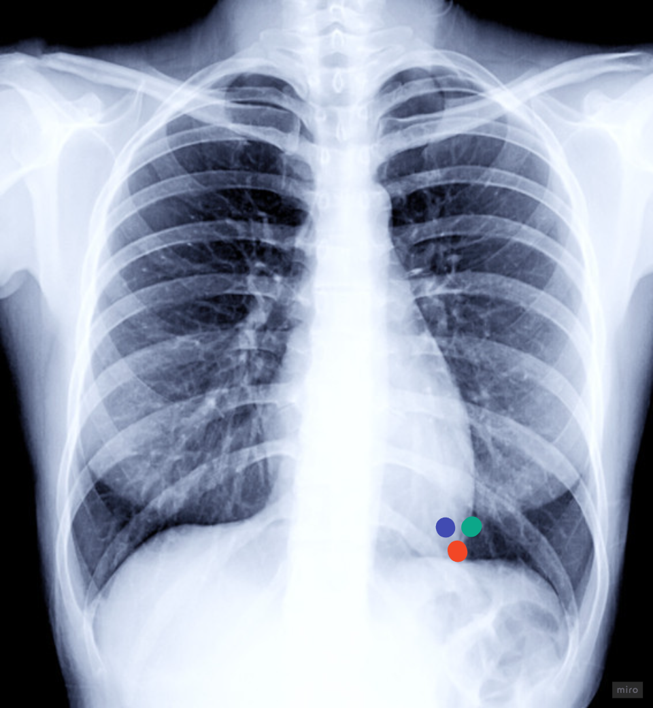
Models may give wrong predictions with a high confidence for both original, and noisy or synthetic inputs
Lecture 6. Loss Functions. Uncertainty Estimation by Alexei Kornaev

Slide 6
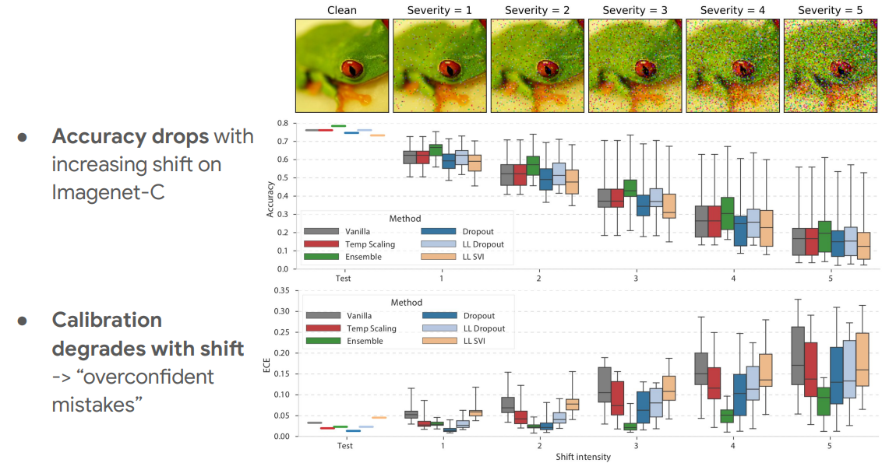
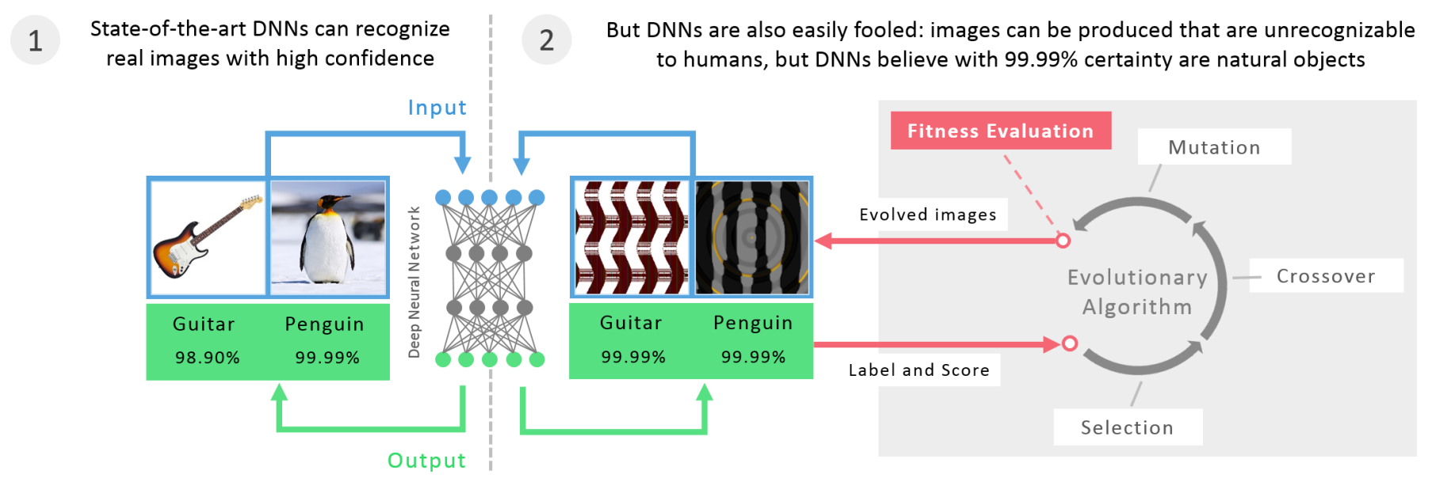
Lecture 6. Loss Functions. Uncertainty Estimation by Alexei Kornaev
Models may give wrong predictions with a high confidence for both original, and noisy or synthetic inputs
Uncertainty and Out-of-Distribution Robustness in Deep Learning, NeurIPS 2020 Tutorial Can You Trust Your Model’s Uncertainty? Evaluating Predictive Uncertainty Under Dataset Shift, Ovadia et al., 2019
Deep Neural Networks are Easily Fooled: High Confidence Predictions for Unrecognizable Images, A. Nguen et al., 2015

Slide 7
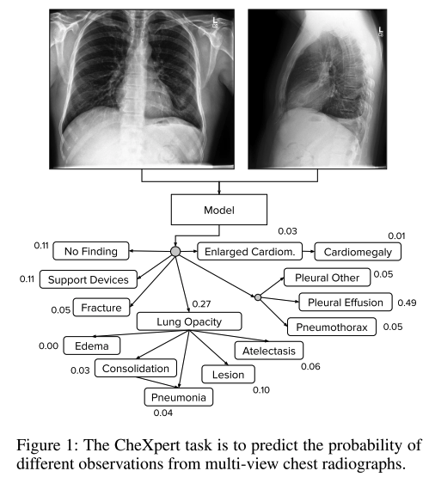
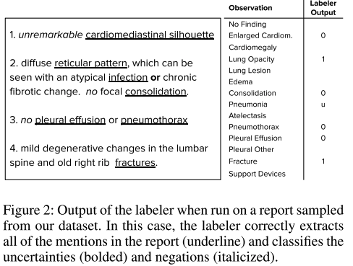
A few more examples of uncertainty: SMTH wrong with the labels
Lecture 6. Loss Functions. Uncertainty Estimation by Alexei Kornaev
Neural Jeremy Irvin et al. CheXpert: A Large Chest Radiograph Dataset with Uncertainty Labels and Expert Comparison. 33rd AAAI Conference on Artificial Intelligence, AAAI 2019. doi = {10.48550/arxiv.1901.07031}

Slide 8
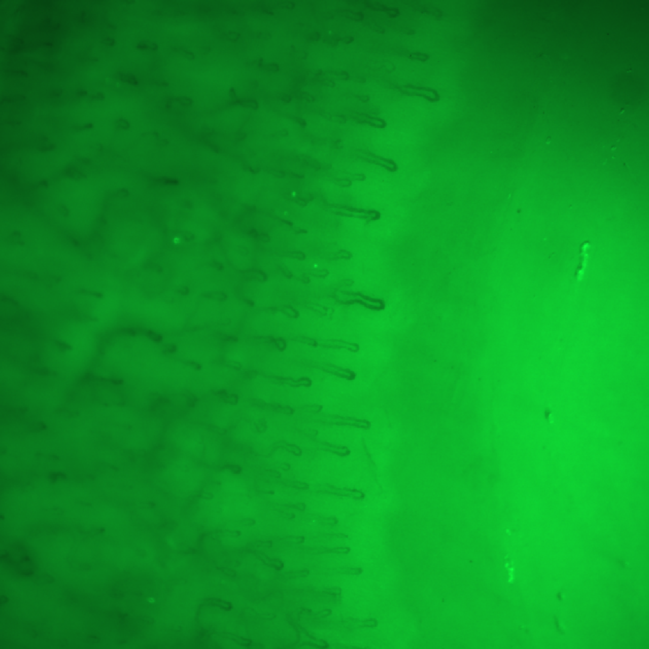

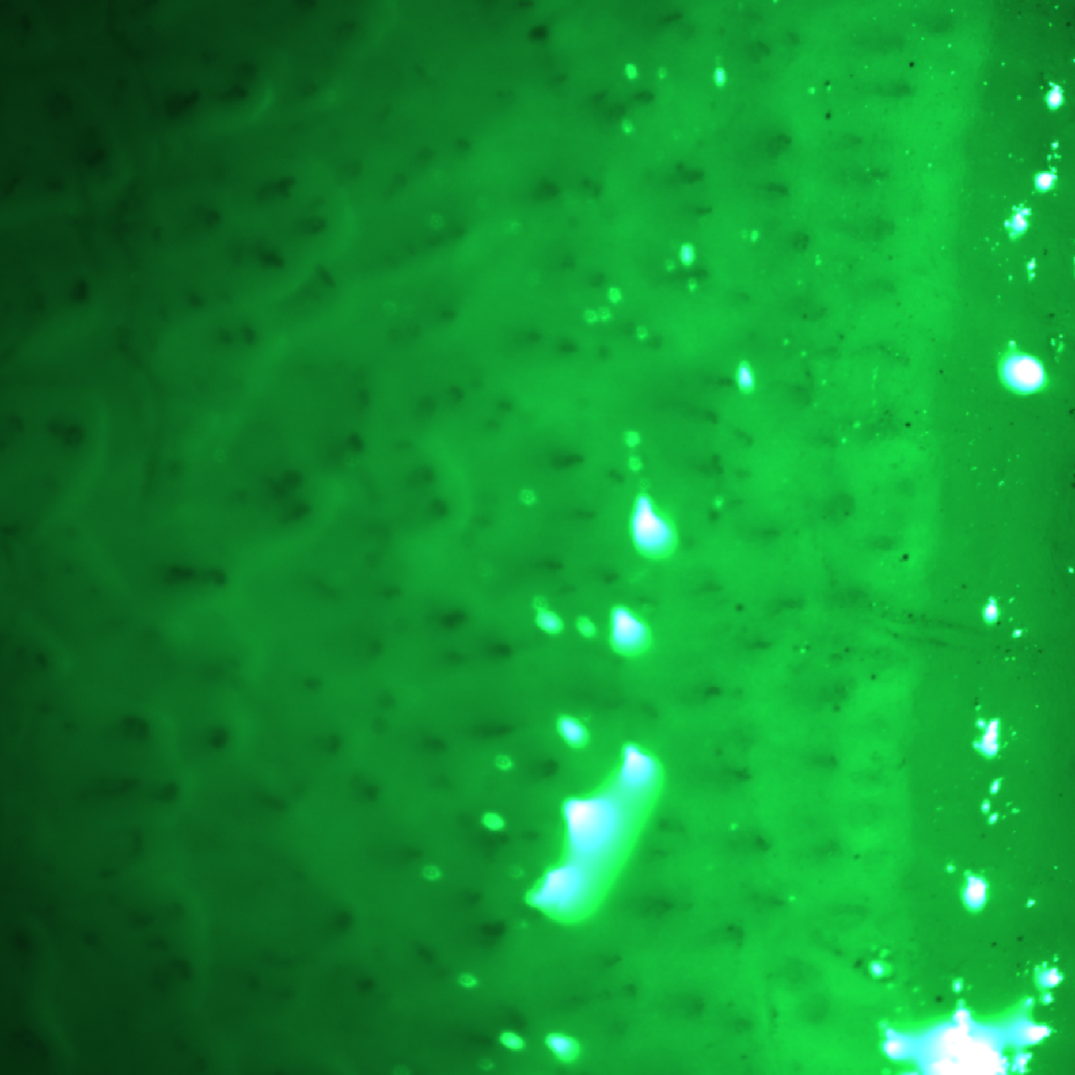

A few more examples of uncertainty: SMTH wrong with the inputs
Lecture 6. Loss Functions. Uncertainty Estimation by Alexei Kornaev
Normal
Low capillary density
Low capillary quality
Low image quality

Slide 9

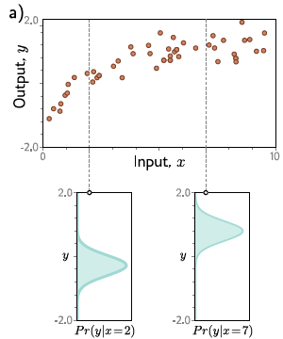
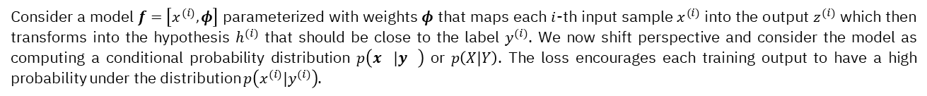
Lecture 6. Loss Functions. Uncertainty Estimation by Alexei Kornaev
Maximum likelihood
Consider a model $f=\left[x^{(i)}, φ\right]$ parameterized with weights $φ$ that maps each $i$-th input sample $x^{(i)}$ into the output $z^{(i)}$ which then transforms into the hypothesis $h^{(i)}$ that should be close to the label $y^{(i)}$. We now shift perspective and consider the model as computing a conditional probability distribution $p\left(x^{}|y^{}\right)$ or $p\left(X|Y\right)$. The loss encourages each training output to have a high probability under the distribution $p\left(x^{(i)}|y^{(i)}\right)$.
S. J. Prince. Understanding Deep Learning. MIT Press, 2023.
9

Slide 10
Lecture 6. Loss Functions. Uncertainty Estimation by Alexei Kornaev
Maximum likelihood →minimum negative log-likelihood criterion
Two assumptions shold be met. First, we assume that the data are identically distributed. Second, we assume that the conditional distributions $p\left(x^{(i)}|y^{(i)}\right)$ are independent. In other words, the data are independent and identically distributed (i.i.d.).
S. J. Prince. Understanding Deep Learning. MIT Press, 2023.
10

Slide 11
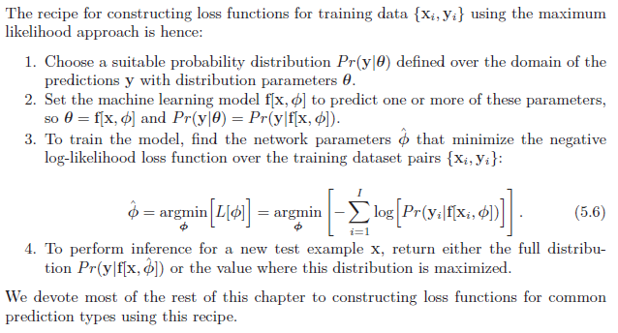
Lecture 6. Loss Functions. Uncertainty Estimation by Alexei Kornaev
Algorithm for constructing loss funtions
S. J. Prince. Understanding Deep Learning. MIT Press, 2023.
11

Slide 12
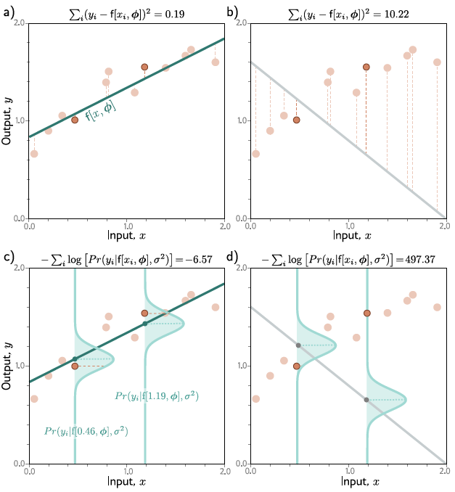
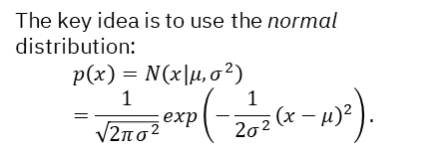
Lecture 6. Loss Functions. Uncertainty Estimation by Alexei Kornaev
Example 1: Regression (univariate, homoscedastic) and MSE loss
The key idea is to use the normal distribution:
$$p\left(x\right)=N\left(x|μ,σ^{2}\right)=\frac{1}{\sqrt{2πσ^{2}}}exp\left(−\frac{1}{2σ^{2}}{\left(x−μ\right)}^{2}\right).$$
S. J. Prince. Understanding Deep Learning. MIT Press, 2023.
12

Slide 13
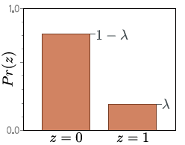
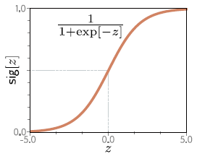
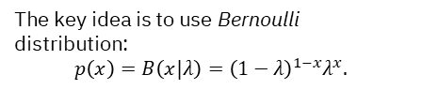
Lecture 6. Loss Functions. Uncertainty Estimation by Alexei Kornaev
Example 2: Logistic regression and binary cross-entrophy loss (BCE)
The key idea is to use Bernoulli distribution:
$$p\left(x\right)=B\left(x|λ\right)={\left(1−λ\right)}^{1−x}λ^{x}.$$
S. J. Prince. Understanding Deep Learning. MIT Press, 2023.
13

Slide 14
Lecture 6. Loss Functions. Uncertainty Estimation by Alexei Kornaev
Frequentist vs Bayesian frameworks
 | Frequentist | Bayesian
Randomness | Objective indefiniteness | Subjective ignorance
Inference | Random and Deterministic | Everything is random
Estimates | Maximal likelihood | Bayes theorem
Applicability | $$n≫size(θ)$$ | $$∀n$$
Deep Bayes School
14

Slide 15
Agenda
Lecture 6. Loss Functions. Uncertainty Estimation by Alexei Kornaev
MAXIMUM LIKELIHOOD CRITERION (MLC)
UNCERTAINTY ESTIMATION USING MLC
UNCERTAINTY ESTIMATION IN GENERAL

Slide 16
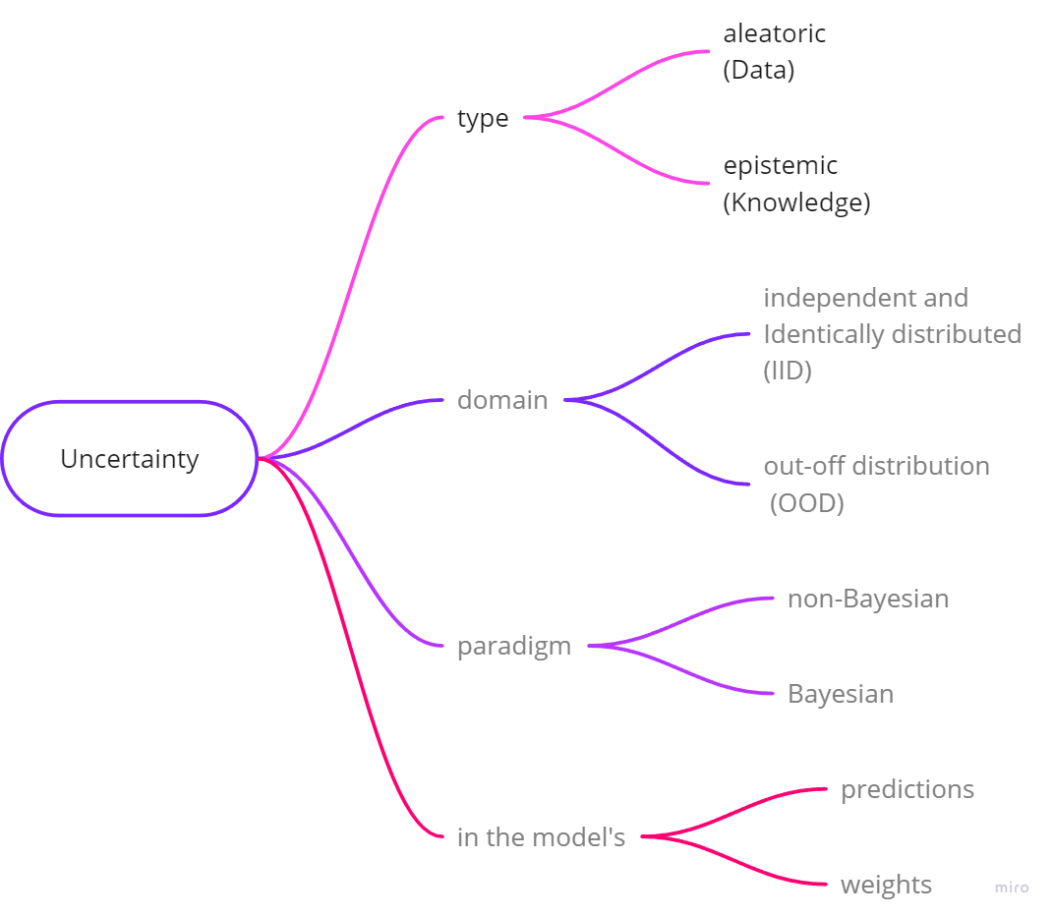

Lecture 6. Loss Functions. Uncertainty Estimation by Alexei Kornaev
Terms and formalization
Would adding the blue data points reduce the uncertainty?
Nope, if the uncertainty is aleatoric (U is irreducible).
Yeap, if the uncertainty is epistemic (U is reducible).
$$y$$
True physical law
Measurements
Model
$$x$$
Brain map for the uncertainty estimation
Aleatoric and Epistemic uncertainty intuition

Slide 17
Agenda
Lecture 6. Loss Functions. Uncertainty Estimation by Alexei Kornaev
MAXIMUM LIKELIHOOD CRITERION (MLC)
UNCERTAINTY ESTIMATION USING MLC
UNCERTAINTY ESTIMATION IN GENERAL

Slide 18

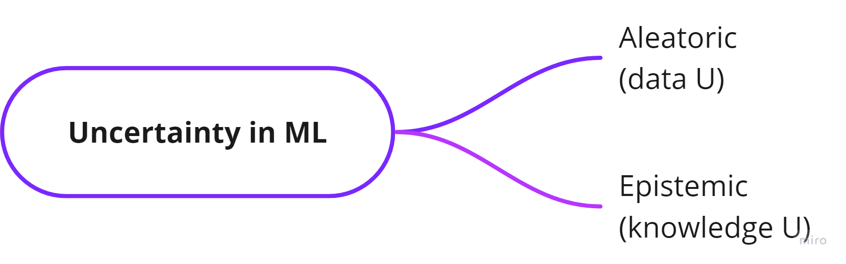
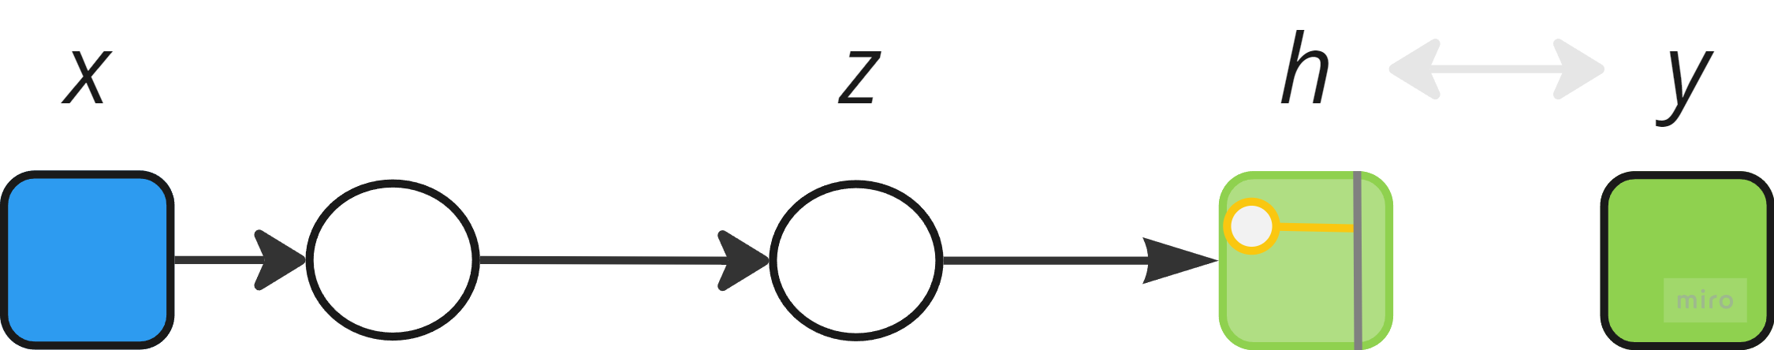
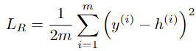
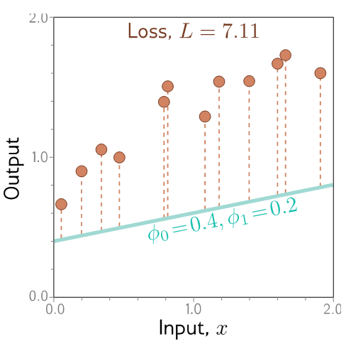
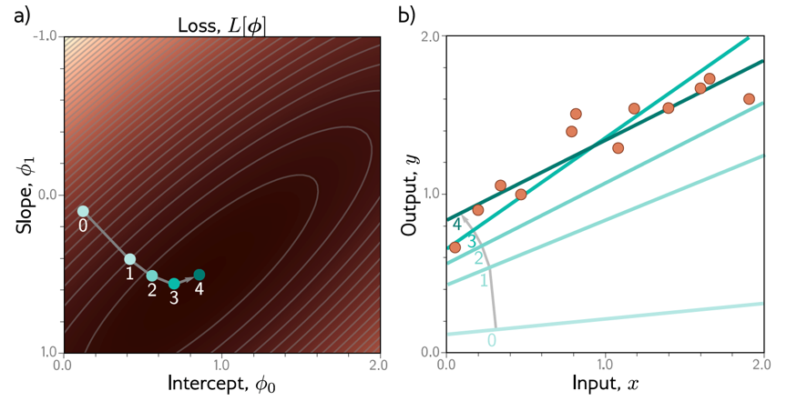
An uncertainty-aware loss intuition Homoscedastic regression vs heteroscedastic regression
Lecture 6. Loss Functions. Uncertainty Estimation by Alexei Kornaev
Model predicts output h given input x
Supervised learning intuition: S. J. Prince. Understanding Deep Learning. MIT Press, 2023. URL http://udlbook.com.

Slide 19
19

Slide 20
20

Slide 21
21

Slide 22
22

Slide 23
23

Slide 24
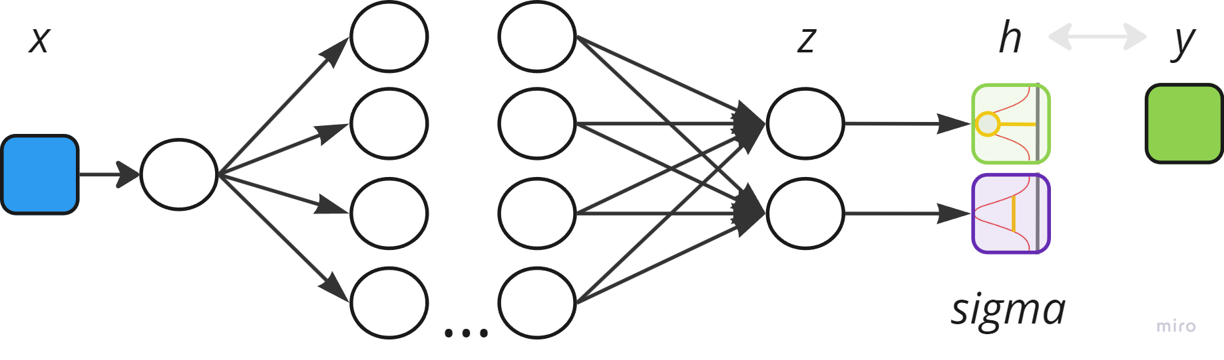
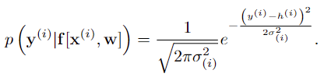
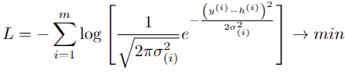
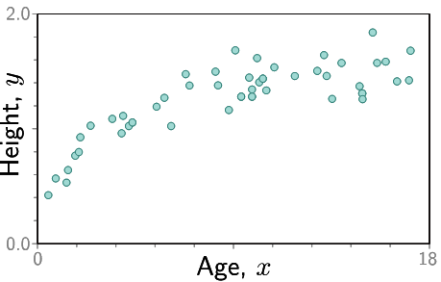
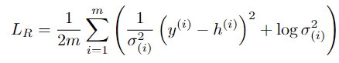
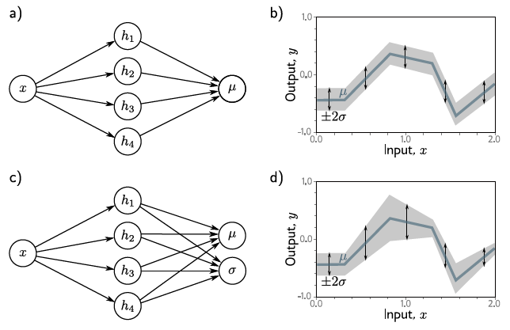
An uncertainty-aware loss intuition Homoscedastic regression vs heteroscedastic regression
Lecture 6. Loss Functions. Uncertainty Estimation by Alexei Kornaev
Model predicts output h given input x
Model predicts a conditional probability distribution p(y|x) over outputs h given input x
Supervised learning intuition: S. J. Prince. Understanding Deep Learning. MIT Press, 2023. URL http://udlbook.com.

Slide 25
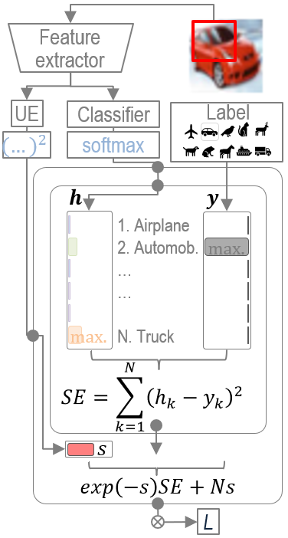
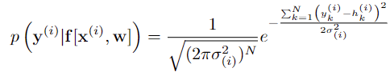
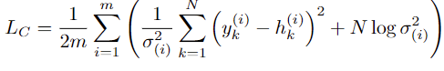
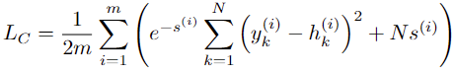

Lecture 6. Loss Functions. Uncertainty Estimation by Alexei Kornaev
An uncertainty-aware loss intuition Trick that allows to use a regression loss in classification
An uncertainty-aware negative log-likelihood (UANLL) loss intuition.

Slide 26
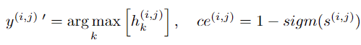
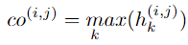

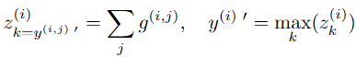
Lecture 6. Loss Functions. Uncertainty Estimation by Alexei Kornaev
An uncertainty-aware loss intuition Classification. Use a sample with its different test-time augmentations to calculate multiple predictions, then calculate the final prediction

Slide 27
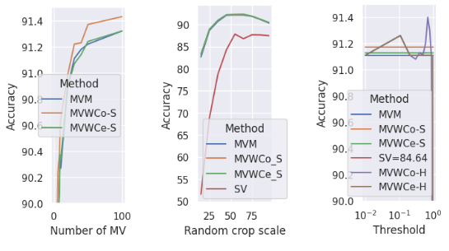
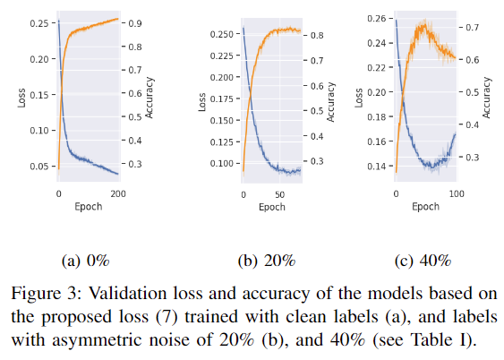
Asymmetric noise in labels. Training of the models with 0%, 20%, and 40%: of replaced labels: airplane ↔ bird, automobile ↔ truck, cat ↔ dog, deer ↔ horse
Lecture 6. Loss Functions. Uncertainty Estimation by Alexei Kornaev
Uncertainty-aware negative log-likelihood (UANLL) loss intuition.
27

Slide 28
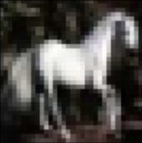


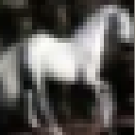
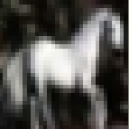



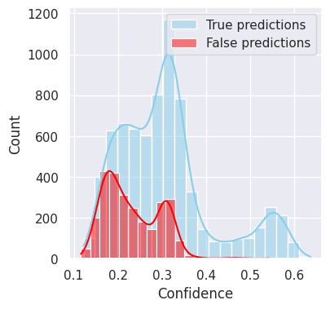
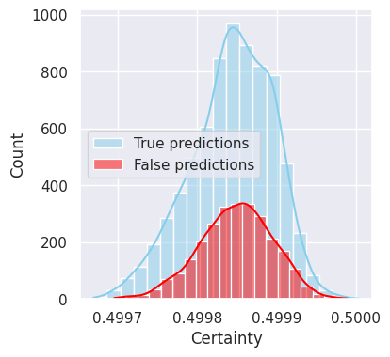
Asymmetric noise in labels. Test-time augmentation
Lecture 6. Loss Functions. Uncertainty Estimation by Alexei Kornaev
Neptune run: Play-934
Assymptotic noise in labels of 40%:
airplane ↔ bird, automobile ↔ truck, cat ↔ dog, deer ↔ horse
Loss: UANLL
Test sample: i = 14
True class: 7 (horse)
# test-time augmentation (TTA) times: 5
Pred. class = [7, 7, 7, 4, 4] // horse and deer
Threshold: t = 0,34
co_s = [0.3575, 0.3309, 0.3409, 0.3105, 0.2684] // confidences
co_h = [1, 0, 1, 0, 0]
ce_s = [0.4999, 0.4999, 0.4998, 0.4999, 0.4999] // certainties
ce_h = [1, 1, 1, 1, 1]
Label
horse
1,03
TTACo-S
deer
0,58
t
horse
0.36
horse
0.33
horse
0.34
deer 0.31
deer 0.27
TTACo-H
1
0
1
0
0
2
0
28

Slide 29
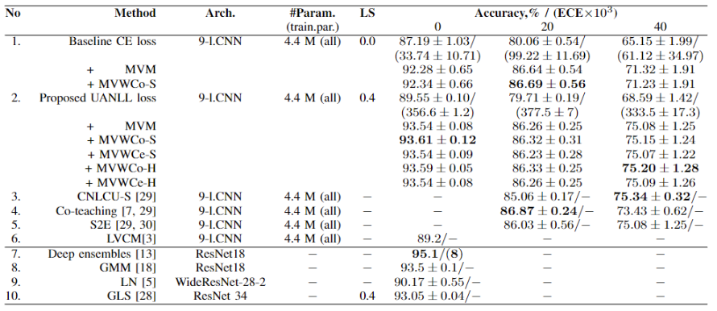


Asymmetric noise in labels. Comparison and ablation study
Lecture 6. Loss Functions. Uncertainty Estimation by Alexei Kornaev
Uncertainty-aware negative log-likelihood (UANLL) loss intuition.
29

Slide 30
Agenda
Lecture 6. Loss Functions. Uncertainty Estimation by Alexei Kornaev
MAXIMUM LIKELIHOOD CRITERION (MLC)
UNCERTAINTY ESTIMATION USING MLC
UNCERTAINTY ESTIMATION IN GENERAL

Slide 31


Lecture 6. Loss Functions. Uncertainty Estimation by Alexei Kornaev
Terms and formalization
$$y$$
True physical law
Measurements
Model
$$x$$
Aleatoric and Epistemic uncertainty intuition
Brain map for the uncertainty estimation

Slide 32


Lecture 6. Loss Functions. Uncertainty Estimation by Alexei Kornaev
Label smoothing
Is a regularization technique used in machine learning, particularly in classification tasks, to improve the performance and generalization of models. It addresses the issue of overfitting by making the model less confident about its predictions.
Traditional One-Hot Encoding
In a typical classification problem, the target labels are represented as one-hot vectors. For example, if you have a 3-class problem, the labels might be:
Class 1: [1, 0, 0]
Class 2: [0, 1, 0]
Class 3: [0, 0, 1]
Label Smoothing:
Instead of using the exact one-hot vectors, label smoothing introduces a small amount of noise to the labels. This is done by replacing the hard 0s and 1s with values slightly less than 1 and slightly greater than 0, respectively. For example, with a smoothing factor ϵ (typically a small value like 0.1), the smoothed labels for a 3-class problem might look like:
Class 1: [1−ϵ,ϵ/2,ϵ/2][1−ϵ,ϵ/2,ϵ/2]
Class 2: [ϵ/2,1−ϵ,ϵ/2][ϵ/2,1−ϵ,ϵ/2]
Class 3: [ϵ/2,ϵ/2,1−ϵ][ϵ/2,ϵ/2,1−ϵ]
R Muller et al. When does label smoothing help? NIPS, 2019
32

Slide 33


Lecture 6. Loss Functions. Uncertainty Estimation by Alexei Kornaev
Temperature scaling
Is a post-hoc calibration technique used to improve the calibration of a trained neural network model. It is particularly useful for models that produce overconfident or underconfident predictions. The idea behind temperature scaling is to adjust the logits (raw output scores before applying the softmax function) by a scalar temperature parameter, which helps in smoothing or sharpening the predicted probabilities.
Ch Guo et al. On Calibration of Modern Neural Networks. ICML, 2017
33

Slide 34

Lecture 6. Loss Functions. Uncertainty Estimation by Alexei Kornaev
Expected calibration error (ECE)
Is a metric used to evaluate the calibration of a classification model. Calibration refers to how well the predicted probabilities of a model match the actual likelihood of the outcomes. In other words, a well-calibrated model should produce probabilities that reflect the true likelihood of the events they predicts.
Suppose we have a model that makes 1000 predictions and we divide the predictions into 10 bins. Here’s a simplified example:
Bin | # Predictions | Avg. Pred. Prob. | Accuracy | Difference
1 | 100 | 0.1 | 0.08 | 0.02
2 | 150 | 0.2 | 0.18 | 0.02
3 | 200 | 0.3 | 0.27 | 0.03
... | ... | ... | ... | ...
10 | 50 | 0.9 | 0.92 | 0.02
Ch Guo et al. On Calibration of Modern Neural Networks. ICML, 2017
34

Slide 35




Dropout training method is identical to approximate variational inference in Bayesian modeling (proved by Yarin Gal in 2016)
Lecture 6. Loss Functions. Uncertainty Estimation by Alexei Kornaev
Dropout: a simple way to prevent neural networks from overfitting
Yarin Gal - Uncertainty in Deep Learning | MLSS Kraków 2023

Slide 36



Ensembling and test-time augmentation
Lecture 6. Loss Functions. Uncertainty Estimation by Alexei Kornaev
MIT Introduction to Deep Learning 6.S191: Lecture 5 Robust and Trustworthy Deep Learning Lecturer: Sadhana Lolla
A review of uncertainty quantification in deep learning: Techniques, applications and challenges

Slide 37

UE in segmentation
Lecture 6. Loss Functions. Uncertainty Estimation by Alexei Kornaev
Alex Kendal and Yarin Gal What Uncertainties Do We Need in Bayesian Deep Learning for Computer Vision?
37

Slide 38


Lecture 6. Loss Functions. Uncertainty Estimation by Alexei Kornaev
Self-study and
self-test questions
We’ve checked the noise in labels case supposing $p\left(y | x\right).$ Can we inverse this idea and suppose that $p\left(x | y\right)$ to study the noise in inputs case?
How does the cross-entropy loss for multiclass classification follows the maximum likelihood?
Why the label smoothing idea works?
Why the expected calibration error (ECE) intuition is based on the statement that in the ideal world the accuracy of the model matches the confidence of the model?
38

Slide 39

Lecture 6. Loss Functions. Uncertainty Estimation by Alexei Kornaev
Thank you for your attention!
a.kornaev@innopolis.ru, @avkornaev

Slide 40
Lecture 6. Loss Functions. Uncertainty Estimation Notes
40

Slide 41
Lecture 6. Loss Functions. Uncertainty Estimation Notes
41

Slide 42
Lecture 6. Loss Functions. Uncertainty Estimation Notes
42

Slide 43
Lecture 6. Loss Functions. Uncertainty Estimation Notes
43

Slide 44

Related work: a square loss classifies well
Like Hui, Mikhail Belkin What Evaluation of Neural Architectures Trained with Square Loss vs Cross-Entropy in Classification Tasks

Slide 45


Related work: ensembling and other methods
Lecture 6. Loss Functions. Uncertainty Estimation by Alexei Kornaev
A review of uncertainty quantification in deep learning: Techniques, applications and challenges
MIT Introduction to Deep Learning 6.S191: Lecture 5 Robust and Trustworthy Deep Learning Lecturer: Sadhana Lolla

